Slide 1
Entity Framework Core
.Net Advanced

Slide 2
Entity Framework Core Intro

Slide 3
Entity Framework
Microsoft’s official data access technology for .NET development
EF Core is a lightweight and extensible version of the popular EF data access technology
EF Core 2 is considered the first solid version
Notes:
Entity Framework Core, or EF Core, is an evolution of Microsoft's object relational mapper, Entity Framework, which has been around since 2008.
It encompasses a set of .NET APIs for performing data access in your software and it's the official data access platform for Microsoft.
The official documentation describes EF Core as a lightweight and extensible version of Entity Framework.
In other words, this was not simply an update from the latest Entity Framework, EF6, it's a different kind of Entity Framework.
EF Core was first released in late June of 2016 after over 2 years of effort, many alphas, many betas, and even a few release candidates, this first version was followed by a great amount of change with EF Core 2, which was released a year later.
Along with .NET Core and ASP.NET Core, EF Core 2 is seen by many as the first solid version, although EF Core 1 is still supported for those instances that are already in production.

Slide 4
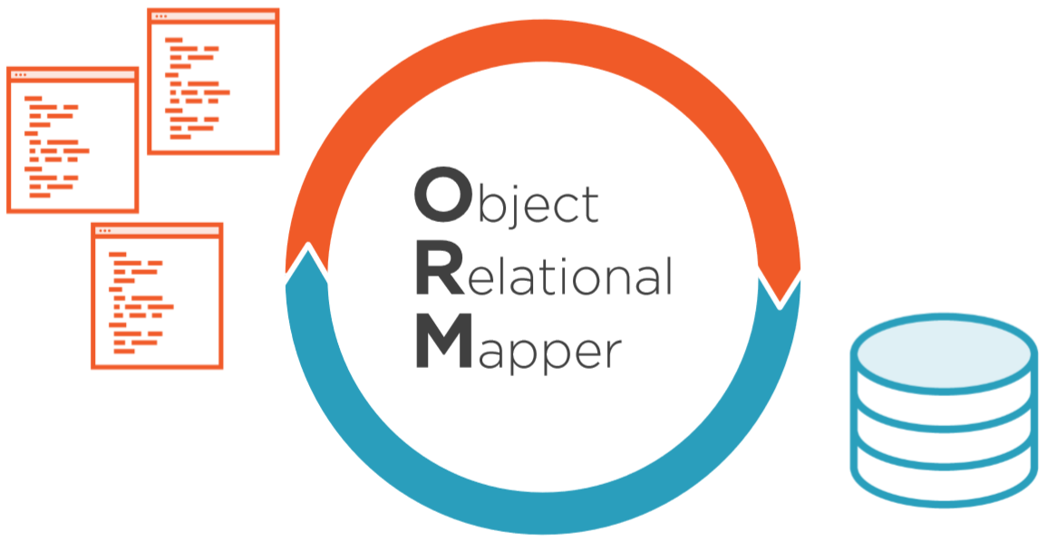
EF is an ORM
Notes:
Object Relational Mappers, or ORMs, are designed to reduce the friction between how data is structured in relational database and how you define your classes.
Without an ORM, we typically have to write a lot of code to transform database results into instances of the types in our software and ORM allows us to express our queries using our classes and then the ORM itself builds and executes the relevant SQL for us, as well as materializing objects from the data that came back from the database.

Slide 5
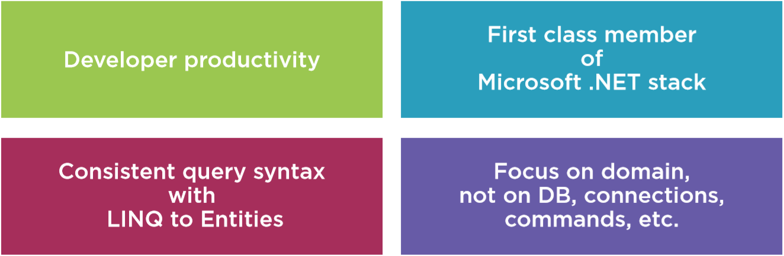
Why Entity Framework?
Notes:
So why an ORM over other ways of doing data access and why this ORM, why Entity Framework Core?
Using an ORM can really eliminate a slew of redundant data interaction coding tasks, and doing so, EF Core can really enhance developer productivity.
It also provides consistency in the tasks that it does, rather than having various members of your team invent their own means of designing their data access tasks.
Not to say that there isn't a learning curve for EF Core, especially if you want to leverage its advanced features, but in simpler scenarios, the learning curve can be quick.
EF Core has a dedicated team at Microsoft and Entity Framework has been around for over 10 years and has gone through a number of evolutionary steps as it gains functionality and has become more sophisticated.
The last version of what we might refer to as classic Entity Framework, and that's EF6, has over 14 million downloads.
It's used in myriad (large) applications and will continue to be supported and maintained, but the evolution to EF Core in order to continue to innovate on Entity Framework shows that this investment will continue to be of high importance to Microsoft.
Most ORMs allow you to connect to a variety of databases and EF Core is no exception.
While Microsoft maintains rich providers for a SQL Server and SQLite and even an in-memory provider that's incredible for automated testing, there are many other third-party providers as well, some commercial and some from the community.
Rather than writing the relevant SQL to target whatever relational database you're working with; EF Core uses the LINQ syntax that's part of the .NET Framework.
LINQ to Entities allows developers to use a consistent and strongly-typed query language regardless of which database they're targeting.
Additionally, LINQ for objects is used for querying other elements in .NET, even in-memory objects.
So developers benefit from their knowledge of LINQ whether they're using LINQ to Entities, LINQ to Objects, or some other flavor of LINQ.
Using an ORM allows developers to focus on their domain, their business rules, and their business objects, they don't have to worry about direct interaction with the database or being intimately familiar with the database schema. Developers still need to understand how Entity Framework Core works and some of its nuances with regards, for example, to tracking changes that need to be persisted to the database or patterns for working disconnected applications, but that follows the importance of understanding how any of your tools work and not just blindly using them in your software.

Slide 6
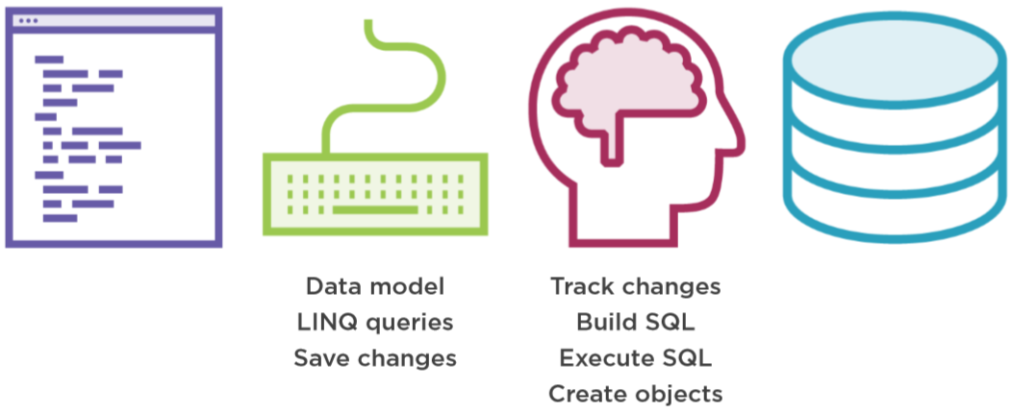
How EF Core works
Notes:
Here is a high-level look at EF Core's workflow which I feel is important to understand before jumping into any code.
The puzzle pieces involved fall into four different categories.
First, you need the classes that describe your domain, the business problem that your software is going to solve, and this part actually has nothing to do with Entity Framework.
Then you use Entity Framework APIs to define a data model based on those domain classes. You also use Entity Framework APIs to write and execute LINQ to Entities queries against those classes, and in your code, you'll need to call Entity Framework's save changes to push data back to the database.
What Entity Framework's APIs will do for you is keep track of the state of objects that it's aware of, it'll determine the SQL it needs to save data back to the database, and for queries, Entity Framework will transform your LINQ to Entities queries into SQL, execute that SQL, and then create objects from the query results.
The last major puzzle piece is that Entity Framework manages all of the interaction with the data store.

Slide 7
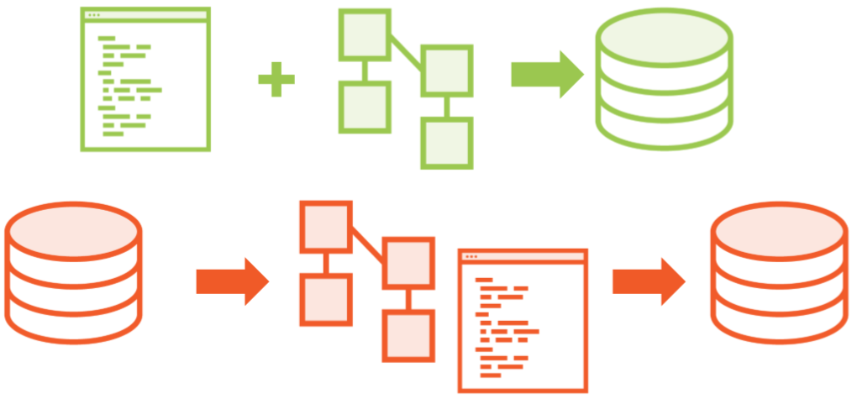
Model Creation Options
Notes:
Green picture
I've talked about the data model being dependent on existing classes.
Some developers are starting a new project from scratch and will most likely start by planning how the domain will function and that will help them define the classes.
Then they can go ahead and code the classes, and when it's time to add in the data persistence, you can then create DB Context classes to define data models that wrap those domain classes.
The data model can then be used with Entity Framework migrations to create and evolve the database, but that's not always how your projects evolve.
Red picture
So often, we already have an existing database and while those database tables, and views, and store procedures may not necessarily reflect what your domain classes should look like, they do provide a good head start and it's possible with Entity Framework Core to start by reverse engineering one or more tables into a DbContext class that is your data model and a set of domain classes, but this is a one-shot deal, it's simply to give you a head start on coding the classes in the context, then you can finetune that data model that got generated and even move forward with migrations to evolve that pre-existing database as the domain evolves.

Slide 8
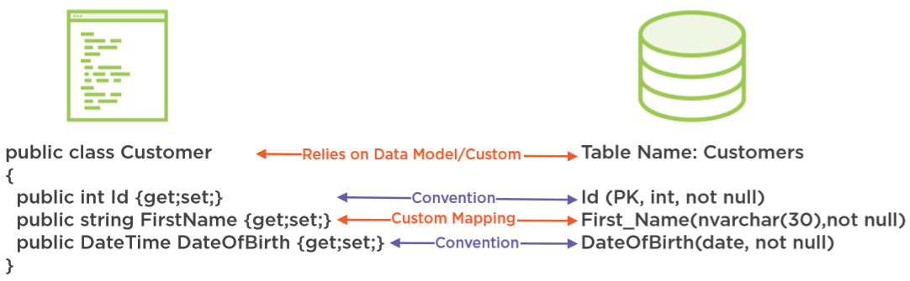
Mapping Classes & Properties to Database
Notes:
When defining the data model, your classes aren't required to exactly match the schema of the database.
Entity Framework does have a lot of default rules for how it will infer what the database schema looks like and that helps it determine what the SQL should be for commands and queries and also how to create objects from query results coming back from the database.
For example, it presumes that property names match the column names in the map table, it also makes presumptions about types in many other facets, but you can affect most of the mappings, for example, a custom mapping is helping Entity Framework understand that the FirstName property doesn't follow convention when it maps to the database, but instead, should map to a column named First_Name that's an nvarchar with a length of 30 and that it's not nullable.
I'll also take advantage of an EF core convention when it is on my context. That's one that ensures Entity Framework will understand that the name of the table I'm mapping to is plural. But keep in mind, these are facets of the database schema and they don't, by default, drive the business logic and validations in your code.

Slide 9
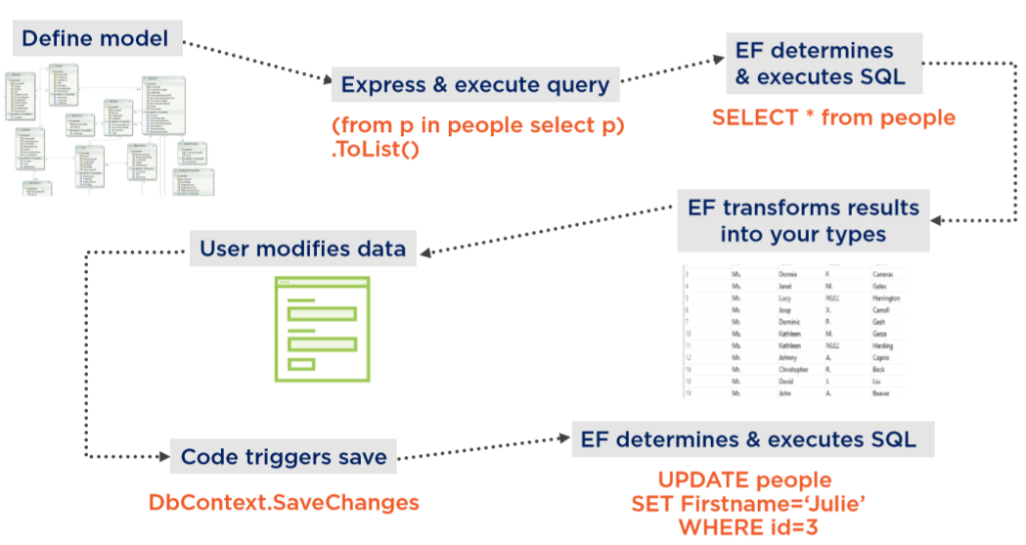
Basic Workflow
Notes:
With this information in hand, let's now look at a basic workflow of how Entity Framework works in an application.
As I said earlier, it all starts with your domain classes, not with Entity Framework, but with those classes, you can then use Entity Framework's DbContext API to wrap the classes into a model and instruct Entity Framework as to how those classes in the model map to the database schema.
With this understanding and the help of the relevant database provider, Entity Framework can then translate queries that you write in LINQ to entities against your classes into SQL that's understood by your database.
It then executes the query and uses the results to return populated instances of your objects, again, taking away all of that redundant work that we normally have to do.
You could also map to views, instead of tables, and if you need to, you can even execute stored procedures, maybe if Entity Framework just can't create efficiently performing SQL or if the query is just too hard to express with LINQ.
Entity Framework can keep track of objects as long as the DbContext is in scope, for example, this could happen in a desktop application. If you edit or add or delete an object, Entity Framework will be aware of it.
With disconnected apps though (e.g. a web application), we do have patterns to inform Entity Framework of this state of an object when it comes back from whatever was working with it.
Then with a single command, save changes, Entity Framework can use all that state information to build and execute the relevant insert, update, or delete commands on the database.

Slide 10
Creating a Data Model and Database with EF Core

Slide 11
Note: .NET Standard dependency
Open console and type dotnet --list-sdks
Check if version 2.2 is installed
Installation instructions
Go to http://microsoft.com/net/download
Click on “All .NET Core downloads…”
Click on “.NET Core 2.2”
Install the latest SDK (this will also install the runtime)
Notes:
Remember that EF Core 2 has a dependency on .NET Standard 2.0.
You can check to see if you've got the correct version using the command line.
First, type dotnet to see if dotnet is even installed.
If it's there, then type dotnet –version to get the latest installed version of .NET Core or type dotnet –list-sdks to list all installed .NET Core versions.
If you need to install the 2.2 version of the SDK, you can go to microsoft.com/net/download to get it.
You'll be downloading the .NET Core SDK, which will also install the runtime for you.
Once that's installed, you can get to work in Visual Studio 2019.

Slide 12
Setting up the Solution
Pluralsight Demo
Start from blank solution without any projects
Add Projects
Class Library (Full .NET) => Domain
Class Library (Full .NET) => Data
Some UI Project (Console, Full .NET)
…
It is a best practice to work with seperate projects for different layers of your application

Slide 13
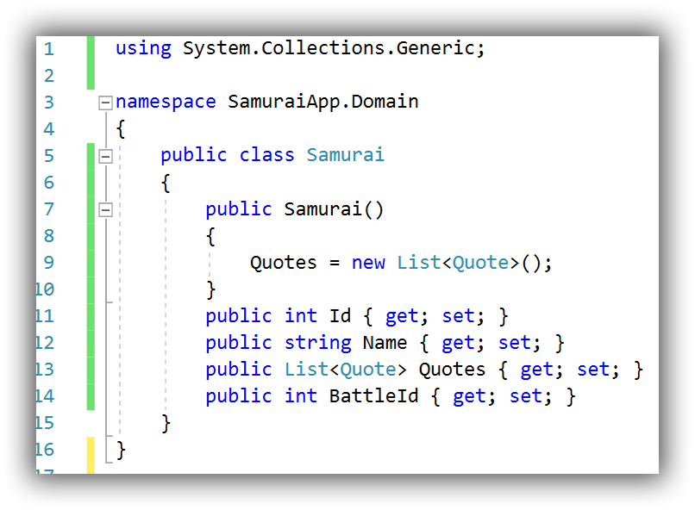
Modelclasses: Samurai
Notes:
In this version there is just a one to many relationship between Batlle and Samurai. A Samurai can only take part in one batlle. This will be fixed later on.
See the demo code in SamuraiApp.Domain project for the other classes: Quote and Samurai.

Slide 14
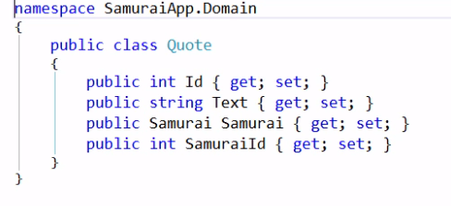
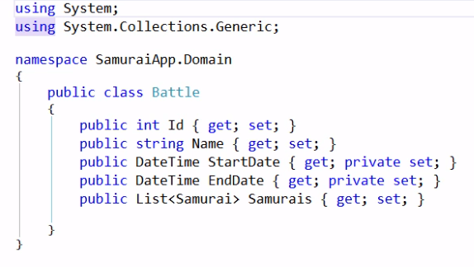
Modelclasses: Quote and Battle

Slide 15
Adding EF Core
Pluralsight Demo
Use Nuget Package Manager
Install it to the “Data”-project
Don’t install the old version 6!
Search for microsoft.entityframeworkcore
Start with the package that holds the dataprovider for the datastore
E.g: Microsoft.EntityFrameworkCore.SqlServer
this brings all dependencies along
Install the 2.2 version (not 3.x)!
Package Manager Console
Notes:
In Package Manager Console, type:
install-package Microsoft.EntityFrameworkCore.SqlServer -Version 2.2.6

Slide 16
Creating the Data Model with EF Core
Pluralsight Demo
Create a public class SamuraiContext
Inherits from DbContext
DbContext provides all the logic that EF uses to do change tracking and DB interaction
Create DBSet-props for all types that you need to interact with
Add a reference to the Domain-project

Slide 17
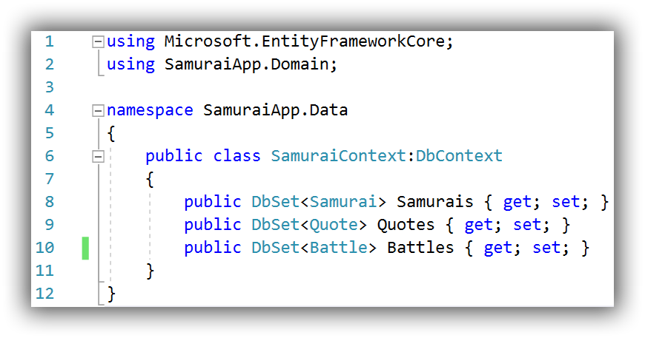
SamuraiContext
Notes:
How you define your DbContext is important to how EF Core treats your data at runtime, as well as how it's able to interact with your database and it can define how you use the model in your coding.
For example, because I've exposed all of these three DbSets, I can directly query the Samurais or the Quotes or the Battles.
EF Core also comprehends the relationships that it discovers in the Entity classes that we've just made it aware of, and based on what the DbContext will discover from the classes,
it will use its own conventions for how to infer the relationships and it will see that there is one-to-many relationship between samurai and quote and that there is a one-to-many relationship between battle and samurai.
The DbContext also affects how EF Core infers the database schema whether you're working with an existing database or you're going to let EF Core create the database based on this model.
For example, EF Core will presume that the table names match these DbSet names.
There is a lot you can do to affect how EF Core infers that model at runtime as it reads the DbContext and any other information you might provide, but for now, I'll just stick with the EF Core's defaults given that I've already made it aware of the Samurais, the Battles, and the Quotes.

Slide 18
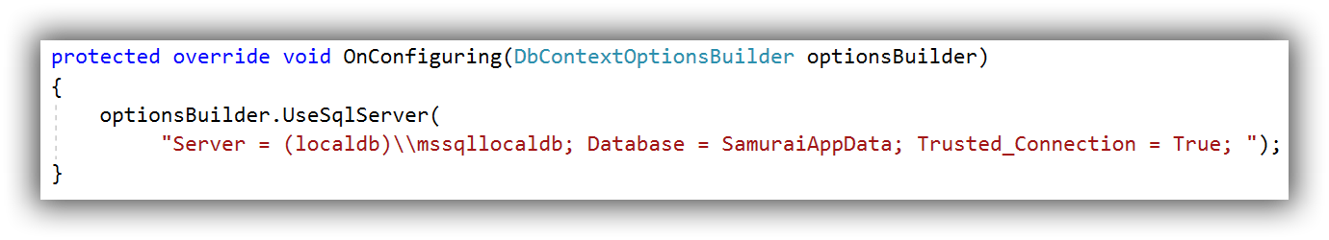
Specifying Data Provider and Connection String
Pluralsight Demo
No (more) database magic
You must provide this info explicitly
Notes:
This method is only suited for demo purposes.
When the DBContext is instantiated, it is aware of the connection string.
Also migrations will benefit from this to create and/or migrate the database.

Slide 19
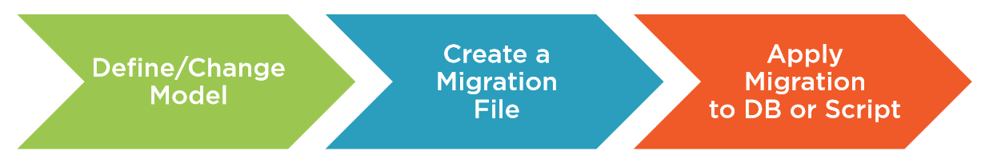
EF Core Migrations
Notes:
If you've never used Entity Framework Migrations before, it's important to understand the basics of what this feature does and its workflow before interacting with the APIs.
Here, I'll provide a quick overview.
Recall the basic workflow of Entity Framework that I introduced you to in the previous module.
Entity Framework needs to be able to comprehend how to build queries that work with your database schema, how to reshape data that's returned from the database in order to create your objects from them, and also as you modify the data, how to get that data into the database.
In order to do that, it has a comprehension about how the data model you've defined through your DbContext maps to the schema of the database and it performs that logic at runtime by reading the DbContext and using its own conventions combined with any additional custom mapping information that you've provided to it to infer the schema of the database, and with that information, it's able to figure out how to do those interactions, how to build queries, how to construct commands to push data to the database, and how to transform database results into your objects.
That also means if you evolve your data model and that could be because you've made changes to the structure of your classes or you've added more information to the DbContext, then Entity Framework's comprehension of the database schema will also change, but that's just what Entity Framework thinks is in the database so it's important to make sure that what it thinks the database looks like is actually what the database looks like.
Along with a code first paradigm with Entity Framework and Entity Framework Core, we also have a full set of APIs referred to as Migrations.
With each change to your model, you can create a new migration that describes the change and then let the Migrations API create the proper SQL script, and if you like, Migrations API can execute that script for you right on the database.

Slide 20
Adding your first migration
Pluralsight Demo
In the Data-Project
Add NuGet package: Microsoft.EntityFrameworkCore.Tools (2.2 version)
In the UI-Project
Add NuGet package: Microsoft.EntityFrameworkCore.Design (2.2 version)
Set as startup project
Reference Data-Project
In the Package manager console
Default Project should be the Data-Project
Get-Help EntityFrameworkCore
Commands
Add-Migration
Update-Database
etc

Slide 21
Inspecting your first migration
Pluralsight Demo
New Folder Migrations in the Data Project
Xxxxx_initial.cs => info to build the database
XXxxxx_Snapshot => version info of the current database/model
Notes:
Let's take a look at the migration I just created.
Notice that there is a new Migrations folder in the data project, and in there is the new migration file called initial along with a timestamp.
There is another file in there called model snapshot and that's where Entity Framework Migrations keeps track of the current state of the model and that's really important because next time you add a migration, EF Core will read that snapshot, compare it to the new version of the model, and that's how it figures out what needs to be changed in the schema.
The snapshot is just a file, it's part of the project, and it can participate fully in source control when you're using EF Core and Migrations across members of your team.
If you're coming from a previous version of Entity Framework and you're on a team that's using migrations, this is probably cause for celebration. This is a really important improvement that we got with EF Core.
The migration uses EF Core's Migration API to describe what needs to happen in the database, and notice the Annotation here, it specifically says SqlServer:ValueGenerationStrategy.
That's because migrations read the configuration information that we supplied in the SamuraiContext and knew that we're targeting SQL Server and so it interacted with the SQL Server provider to determine some important metadata.
Scrolling through the migration file, you can see that it's creating tables, and for the tables, it's creating the columns along with particular attributes for those columns.
Also, notice that it's specifying primary keys and foreign keys, as well as constraints between those primary and foreign keys.
It even specified a few indexes and EF Core's conventional rule behind indexes is to create an index for every one of the foreign keys that it discovers in the model.
All of that is part of a method called Up and here is another method called Down, that's used if we ever want to unwind this particular migration.
So that's it for this first migration and the migration is very similar to how migrations looked in Entity Framework 6. The next step will be to have migrations create the database.

Slide 22
Using Migrations to Script or Directly Create the database
Pluralsight Demo
Script-Migration => T-SQL script
Update-Database => Directly create database
verbose => informative output
Inspect in SQL Server Object Explorer
Tables: Battles, Quotes, Samurais
__EFMigrationsHistory => only Id and version

Slide 23
Adding Many-to-many and One-to-one Relationships
Pluralsight Demo

Slide 24
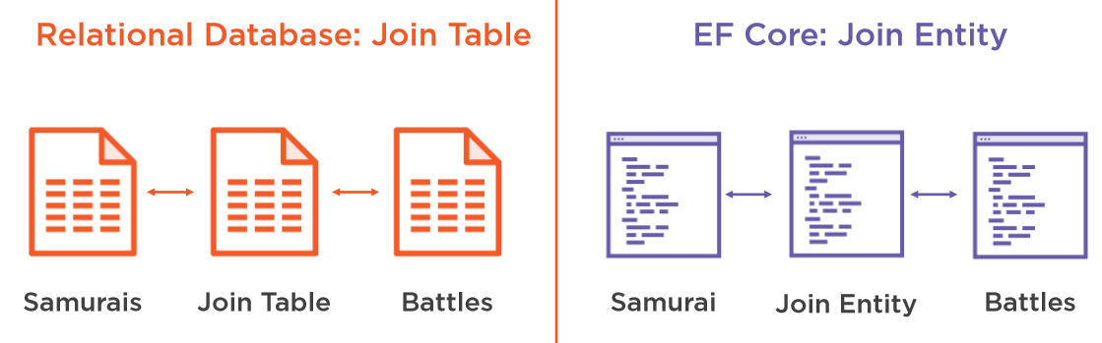
Many-to-Many
Notes:
Rather than have a samurai only be in a single battle, it should be possible for one samurai to fight in many battles and many samurais fight in a single battle, that requires a many-to-many relationship between them.
In EF Core 2, this means a join entity to link them and I'll do that with a new class called SamuraiBattle, it has a SamuraiId and a BattleId, these are required, but the navigation properties to samurai in battle are optional.
Now I need a list of SamuraiBattles in the Samurai class and in the Battle class.
I've commented out the properties that these are replacing.

Slide 25
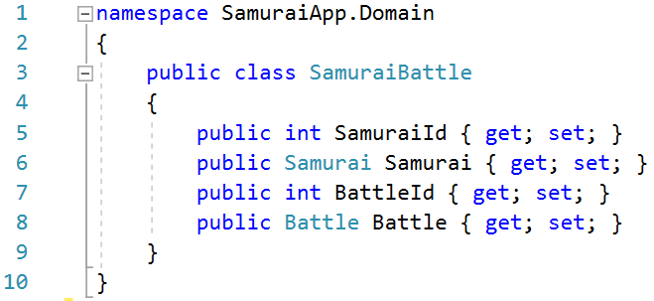
Join Entity
Notes:
SamuraiId and BattleId are required, Samurai and Battle are optional.
However, this is not enough. You have to carry out additional configuration.

Slide 26
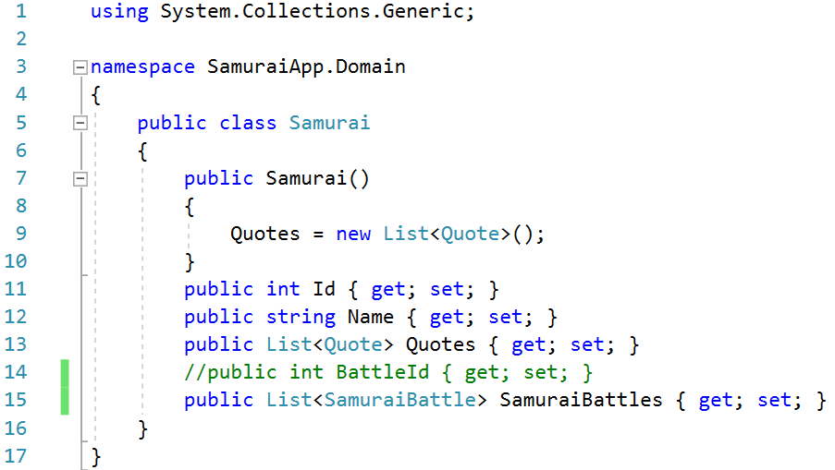
Samurai
Notes:
Samurai
Comment out BattleId and add a list of SamuraiBattle.

Slide 27
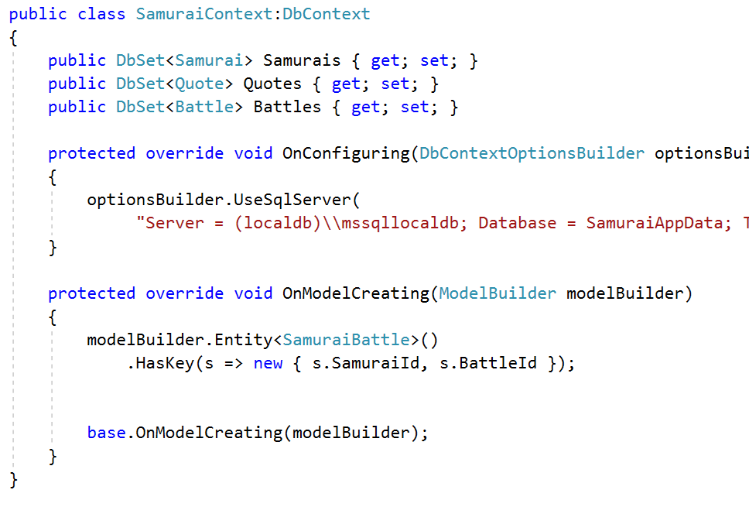
SamuraiContext
Notes:
Use EF Fluent API
The classes are now set up properly, but EF Core can't infer this relationship and won't be able to map to the database nor translate queries and updates, but it's possible to assist EF Core in understanding our intent when it's not following its own conventions.
Here in the SamuraiContext class, I'm using EF Core's Fluent API to do this.
The fluent mappings go into the DbContext onModelCreating method, which gets called internally when EF Core is working out what the data model looks like.
Using the model builder object that EF Core has passed into the method, I've told it that the SamuraiBattle entity has a key composed from its SamuraiId and BattleId properties.
Now EF Core will be able to build the SQL for queries and database updates that respect this many-to-many relationship.
https://www.learnentityframeworkcore.com/configuration/fluent-api

Slide 28
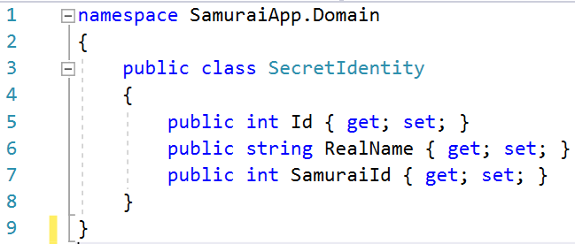
One-To-One Relationship
SecretIdentity <-> Samurai
SecretIdentity holds the real name of a Samurai
Notes:
So let's move onto the one-to-one relationship.
I've created a new class called SecretIdentity to keep track of a samurai's real name.
The new class has an Id, the name, and the Id of the samurai it belongs to.
The Samurai class now has a navigation property to define the secret identity.
With the navigation property in samurai and the foreign key SamuraiId property in the SecretIdentity class, it's enough for EF Core to comprehend the relationship without any more information from me.
Keep in mind that the dependent end of a one-to-one relationship, in this case, the SecretIdentity, is always optional as far as EF Core is concerned, there is no way to apply that constraint in the model, or for that matter, in the database. If you want to require that samurai always has a secret identity, you'll have to do that in your own business logic.

Slide 29
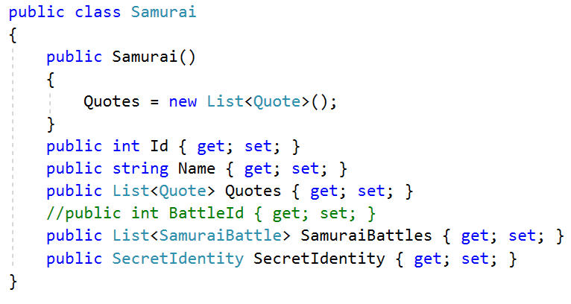

Slide 30
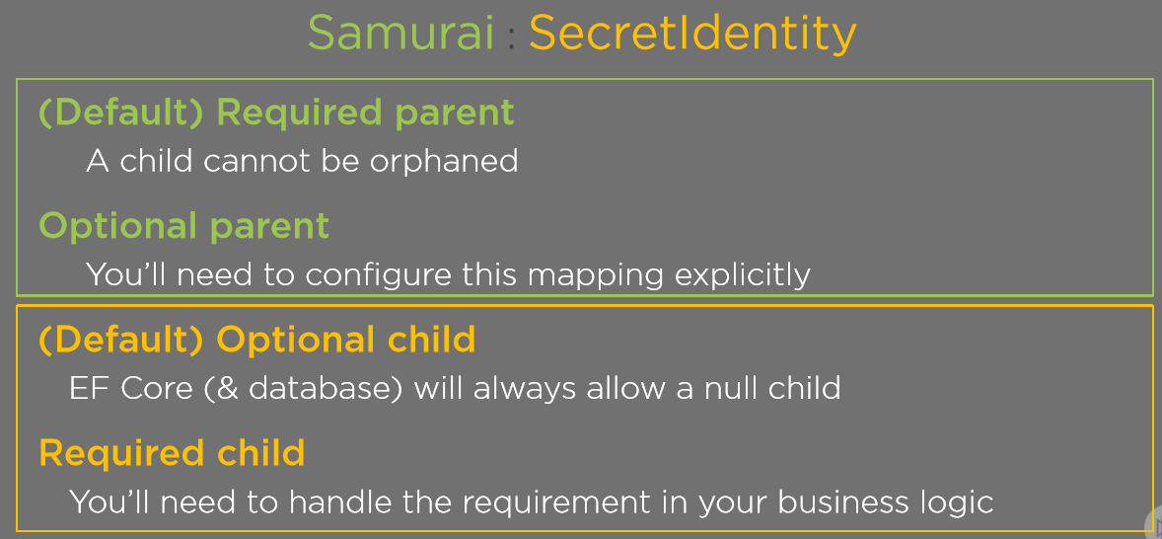

Slide 31
Fluent API
Helps EF to build the model and its database mappings
Docs: https://docs.microsoft.com/ef/core/modeling
Belangrijkste onderdelen:
Configure keys (https://docs.microsoft.com/ef/core/modeling/keys)
Require properties (https://docs.microsoft.com/ef/core/modeling/required-optional?tabs=without-nrt%2Cfluent-api)
Maximum length (https://docs.microsoft.com/ef/core/modeling/max-length)
Relations (https://docs.microsoft.com/ef/core/modeling/relationships?tabs=fluent-api)
Seeding (https://docs.microsoft.com/ef/core/modeling/data-seeding)
Notes:
Configurations are applied via a number of methods exposed by the Microsoft.EntityFrameworkCore.ModelBuilder class.
The DbContext class has a method called OnModelCreating that takes an instance of ModelBuilder as a parameter.
This method is called by the framework when your context is first created to build the model and its mappings in memory.
You can override this method to add your own configurations

Slide 32
Data Seeding
Provide initial data to populate a database
It is part of the model configuration
EF Core migrations compute automatically what insert/update/delete operations are needed
Use HasData-method on Entity class
Notes:
https://docs.microsoft.com/en-us/ef/core/modeling/data-seeding

Slide 33
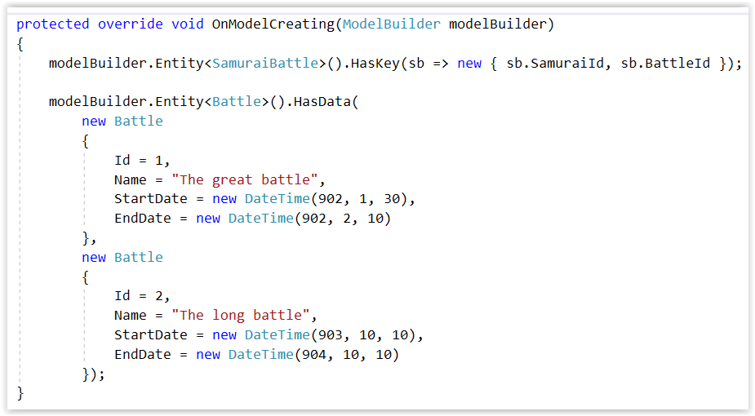
Data Seeding
Notes:
With HasData you configure entities with data. Then you perform a new migration to add these to the migration code:
Add-Migration battledata
Update-Database triggers migrations and therefore creates the necessary data.

Slide 34
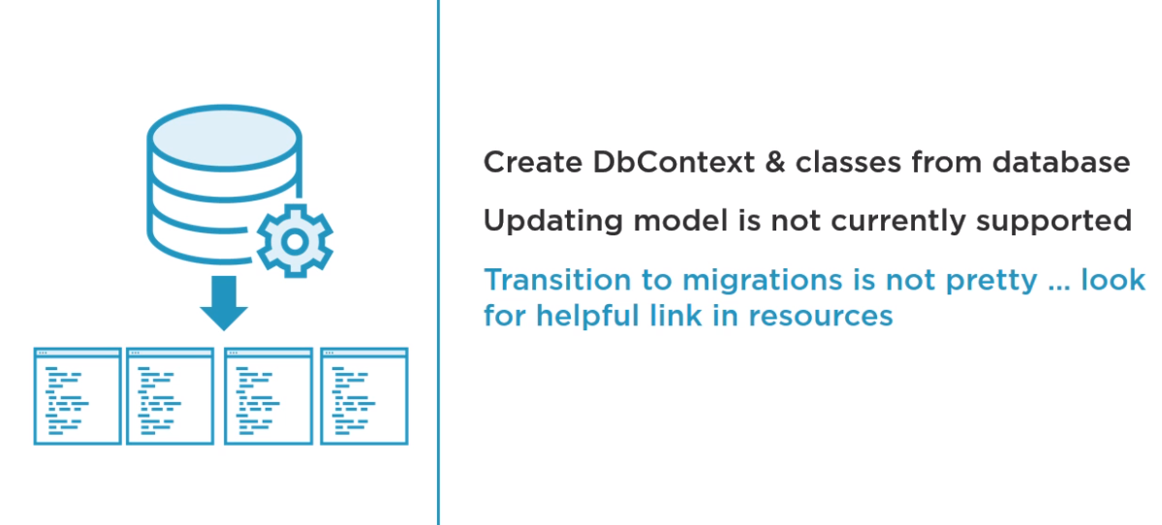
Reverse Engineering an Existing Database
Notes:
Reverse Engineering an Existing Database
We’ve seen how to use migrations to create a database from a DbContext and classes. It's also possible to reverse engineer an existing database into a DbContext and classes. Typically, this is a one-time procedure to get you a head start with your code if you're working with an existing database.
At some point, EF Core will support updating the model with database changes, but that's not possible with EF Core 2. Also, with the current version, it's not easy to begin by reverse engineering an existing database and then migrate the database with model changes.
So you can find a link in the resources to a blog post by Christos Matskas that explains how to make sure you can use migrations after creating your model from an existing database.

Slide 35
Reverse Engineering an Existing Database
Create empty .Net Framework Class Library
Packages added:
EF Core Sql Server
EF Core Tools
Notes:
Reverse Engineering an Existing Database
We will start with an empty .NET Framework class library where EF Core SQL Server package and the EF Core Tools package have been added., along with our dependencies.
Note: in the pluralsight course only the EF Core Design package is added. This is not enough. You should add the EF Core Tools package (which has a dependency on the EF Core Design package.

Slide 36
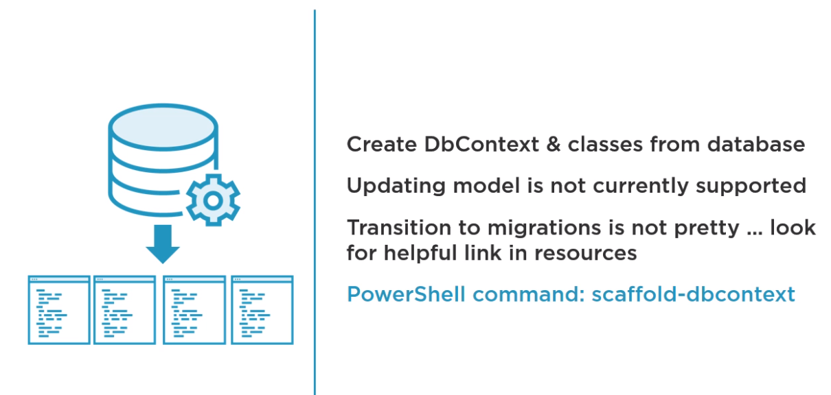
Reverse Engineering an Existing Database
Notes:
Reverse Engineering an Existing Database
The PowerShell command to use for this task is scaffold-dbcontext.

Slide 37
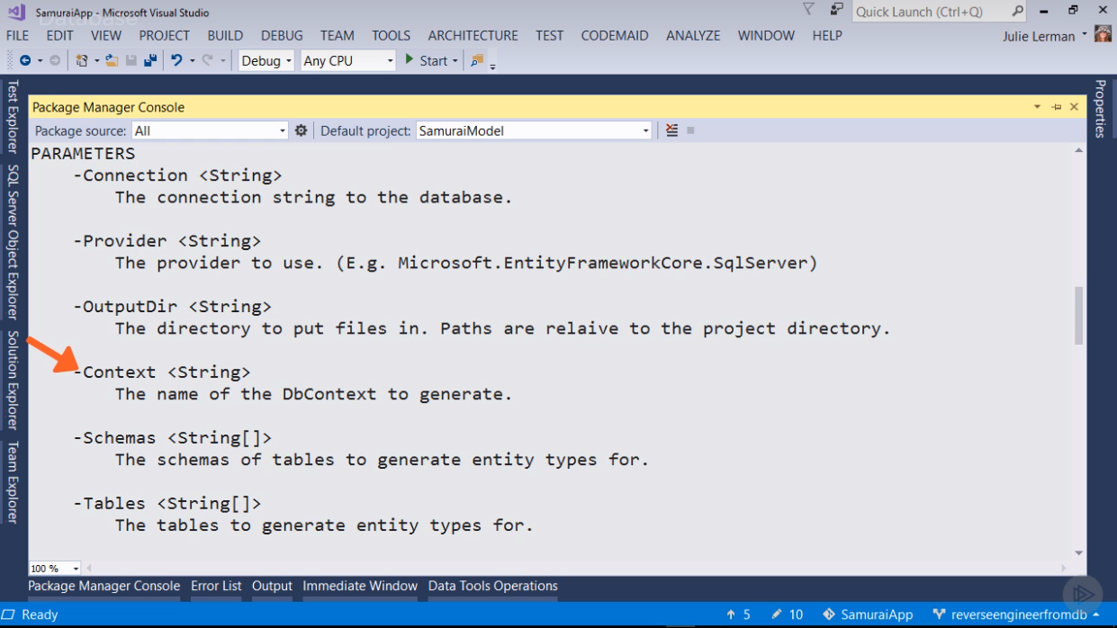
Reverse Engineering an Existing Database
Notes:
Reverse Engineering an Existing Database
On the slide, you can find a list of all its parameters. There is some flexibility as like where the file should be created and what the DbContext should be named. The provider and connection parameters are required, though, which makes sense.

Slide 38
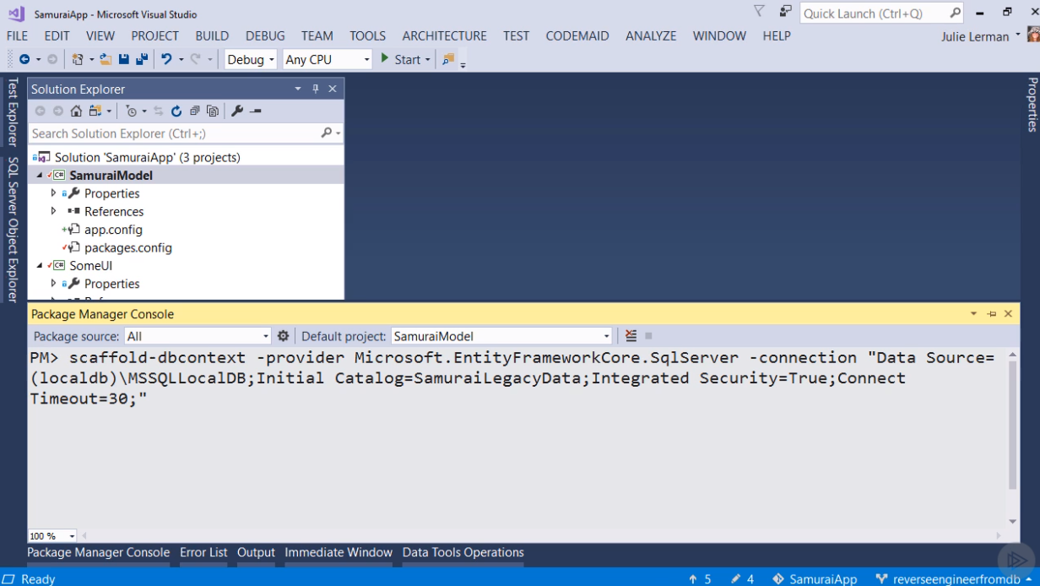
Reverse Engineering an Existing Database
Notes:
Reverse Engineering an Existing Database
Before running the command, ensure that the new project is the default project in the Package Manager Console. It's also the startup project in this solution and that's something that's different than what we have to do for the other migration commands.
Run the scaffold-dbcontext command with just the required parameters. The provider is Microsoft.EntityFrameworkCore.SqlServer and the connection is the connection string for your legacy database.
Notice that the connection string is in quotes. That's because there are spaces in this string. Watch the project in the Solution Explorer when you run the command. A bunch of new files are added in. Since your legacy database has the same schema as the one you've been working with, the classes should be familiar.

Slide 39
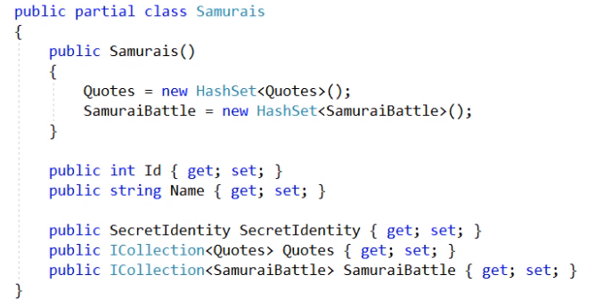
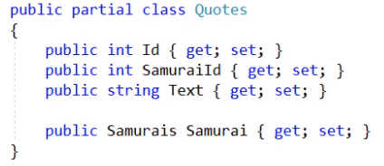
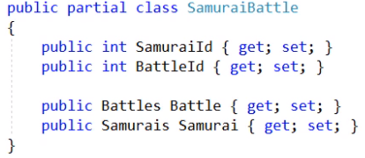
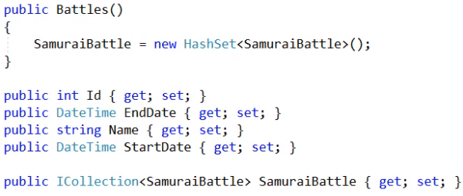
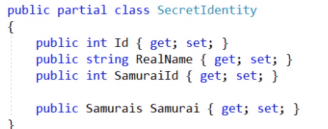
Notes:
Reverse Engineering an Existing Database
There will be a Samurai class with its secret identity and it has an ICollection of Quotes and an ICollection of SamuraiBattle.
You can make the classes your own once the scaffolding is done.
Also, the scaffolding did kindly ensure that the collections are instantiated up front so we don't have to remember to do that in code constantly.
The Quotes class is familiar, so it’s Battles, and the SamuraiBattle class have the Ids that we'll compose for the key and the navigation properties.
There is also the SecretIdentity class.

Slide 40
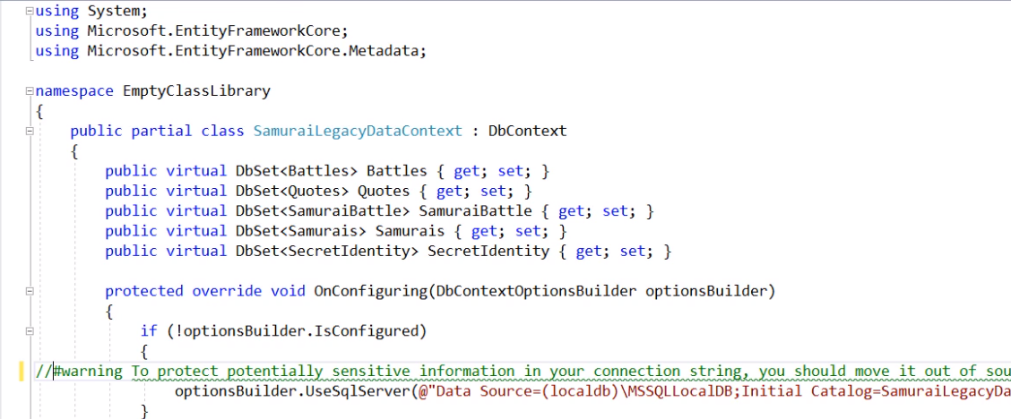
Reverse Engineering an Existing Database
Notes:
Reverse Engineering an Existing Database
There is also the DbContext class.
It created DbSet properties for every one of the Entity classes that was created and that's another default, which you change if you want.
It also put the connection string directly in the OnConfiguring method with a note that you might not want it there for security reasons.
Notice the check to see if the optionsBuilder.isConfigured or not in case you've configured it outside of the DbContext like we do in ASP.NET Core Startup class or maybe even in a test.
There are a bunch of explicit fluent mappings for the indexes, but most importantly, you can find the mapping to specify the compose key for the SamuraiBattle Join entity, which we did earlier as well.

